Slide 1
Introduction to Problem Solving
Rajat Rai
Lecture 01
therajatraiofficial@gmail.com

Slide 2
“Computer Science is a science of abstraction -creating the right model for a problem and devising the appropriate mechanizable techniques to solve it.”
–A. Aho and J. Ullman

Slide 3
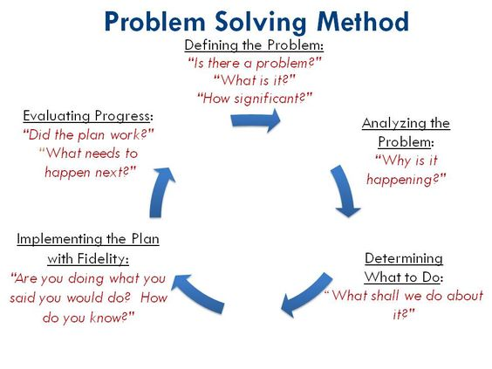
What is Problem Solving ?
Computer science is the study of problems, problem-solving, and the solutions that come out of the problem-solving process.
The fundamental concern of computer science is determining what can and cannot be automated
Problem solving is the act of defining a problem; determining the cause of the problem; identifying, prioritizing, and selecting alternatives for a solution; and implementing a solution.

Slide 4
Algorithms: Problem solving made easy….
Algorithm can be defined as: “A sequence of activities to be processed for getting desired output from a given input.”
According to Wikipedia, in mathematics and computer science, an algorithm is a finite sequence of well-defined instructions, typically used to solve a class of specific problems or to perform a computation.
To be an algorithm, a set of rules must be unambiguous and have a clear stopping point”.

Slide 5
Example of Algorithm
Algorithm:
Step1: Read\input the Radius r of the Circle
Step2: Area ←PI*r*r // calculation of area
Step3: Print Area
Problem 1:
Find the area of a Circle of radius r.
Inputs to the algorithm:
Radius r of the Circle.
Expected output:
Area of the Circle

Slide 6
Another Example of Algorithm
Problem 02
Write an algorithm to read two numbers and find their sum.
Inputs to the algorithm:
First num1.
Second num2.
Expected output:
Sum of the two numbers.
Algorithm:
Step1: Start
Step2: Read\input the first num1.
Step3: Read\input the second num2.
Step4: Sum ← num1+num2 // calculation of sum
Step5: Print Sum
Step6: End

Slide 7
Properties of Algorithms
Unambiguous − Algorithm should be clear and unambiguous. Each of its steps (or phases), and their inputs/outputs should be clear and must lead to only one meaning.
Input − An algorithm should have 0 or more well-defined inputs.
Output − An algorithm should have 1 or more well-defined outputs, and should match the desired output.
Finiteness − Algorithms must terminate after a finite number of steps.
Feasibility − Should be feasible with the available resources.
Independent − An algorithm should have step-by-step directions, which should be independent of any programming code.

Slide 8
Types of Algorithms
The algorithm and flowchart, classification to the three types of control structures. They are:
Sequence
Branching (Selection)
Loop (Repetition)

Slide 9
The Sequence
The sequence is exemplified by sequence of statements place one after the other – the one above or before another gets executed first.
In flowcharts, sequence of statements is usually contained in the rectangular process box.
Example
Step 1 − START ADD
Step 2 − get values of a & b
Step 3 − c ← a + b
Step 4 − display c
Step 5 − STOP

Slide 10
The Branching
Example
Problem1: write algorithm to find the greater number between two numbers
Step1: Start
Step2: Read/input A and B
Step3: If A greater than B then C=A Step4: if B greater than A then C=B Step5: Print C
Step6: End
The branch refers to a binary decision based on some condition.
If the condition is true, one of the two branches is explored; if the condition is false, the other alternative is taken.
This is usually represented by the ‘if-then’ construct in pseudo-codes and programs.
In flowcharts, this is represented by the diamond-shaped decision box.
This structure is also known as the selection structure.

Slide 11
The Loop
The loop allows a statement or a sequence of statements to be repeatedly executed based on some loop condition. It is represented by the ‘while’ and ‘for’ constructs in most programming languages, for unbounded loops and bounded loops respectively.
(Unbounded loops refer to those whose number of iterations depends on the eventuality that the termination condition is satisfied; bounded loops refer to those whose number of iterations is known before-hand.)
In the flowcharts, a back arrow hints the presence of a loop. A trip around the loop is known as iteration.
You must ensure that the condition for the termination of the looping must be satisfied after some finite number of iterations, otherwise it ends up as an infinite loop, a common mistake made by inexperienced programmers. The loop is also known as the repetition structure.

Slide 12
A Example of Loop
Problem1: An algorithm to calculate even numbers between 0 and 99
1. Start
2. I ← 0
3. Write I in standard output
4. I ← I+2
5. If (I <=98) then go to line 3
6. End

Slide 13
Introduction of Flowchart
The flowchart is a diagram which visually presents the flow of data through processing systems.
This means by seeing a flow chart one can know the operations performed and the sequence of these operations in a system.
Algorithms are nothing but sequence of steps for solving problems. So a flow chart can be used for representing an algorithm.
A flowchart, will describe the operations (and in what sequence) are required to solve a given problem.
You can see a flow chart as a blueprint of a design you have made for solving a problem.

Slide 14
Flowchart Symbols
There are 6 basic symbols commonly used in flowcharting of Programs:
Terminal,
Process,
input/output,
Decision,
Connector
and Predefined Process.

Slide 15
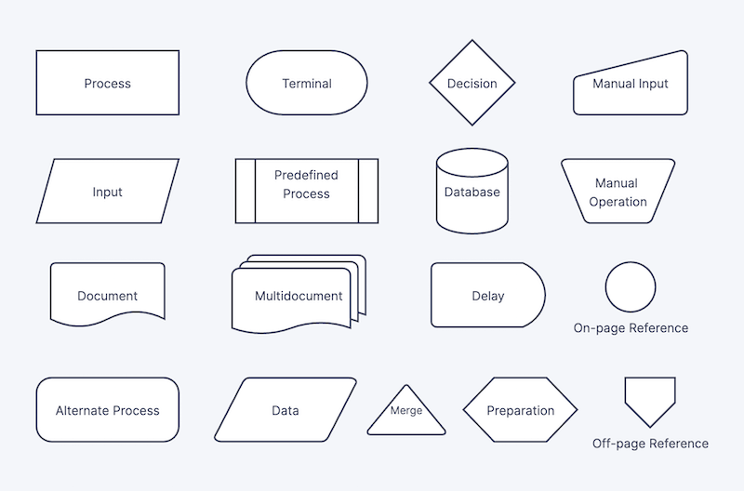

Slide 16
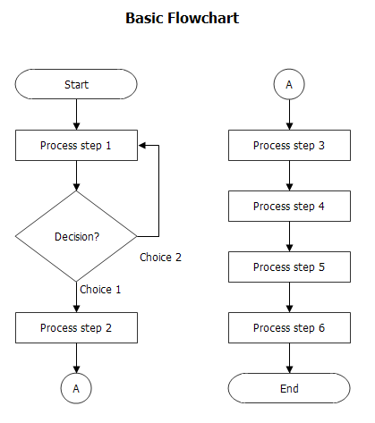

Slide 17
General Rules for flowcharting
Each flowchart must have one and only one Start object.
The flow of control must always enter an object from the top.
The flow of control must always leave an object from the bottom (except for Decision objects, which allow the flow of control to leave from the side).
The flow of control must not split. You can use Decision objects to give the flow of control a choice of paths to follow, but it can only follow one of these paths.

Slide 18
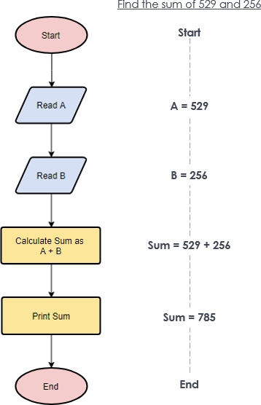
Examples of Flowchart

Slide 19
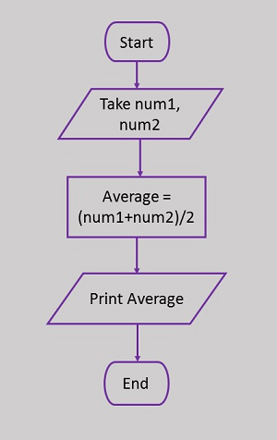
Examples of Flowchart

Slide 20
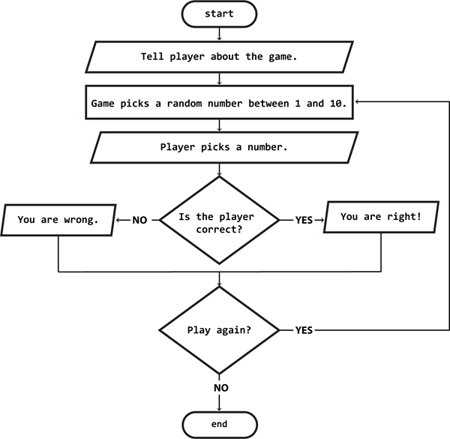
Examples of Flowchart

Slide 21
Assignment 01 Due Date : 26 April 2022 ( 11:59 PM )
Problem 01:
Why do we need an algorithm ? Design an algorithm to convert a decimal number, n, to binary format?
Problem 02:
Draw flowchart for the problem of determining prime number?
Draw a flowchart to find the sum of first 10 natural numbers.
Problem03:
Write about the advantages & disadvantages of Flowchart and Algorithms.

